Slide 1

Vel Tech Rangarajan Dr. Sagunthala R&D Institute of Science and Technology
School of Computing
Department of Computer Science and Engineering
10211CS224 / FULL STACK APPLICATION DEVELOPMENT (JAVA)
PROJECT REVIEW : MILESTONE PROJECT – 1
Date: 03-03-2026
PROJECT TITLE
SDG: SDG No – SDG Title(Example: SDG 4 – Quality Education)
Presented By:
AFROSE BEEMA M A – VTU24445– Reg.No:23UECS0651
Courses Handling Faculty:
Dr./Mr./Mrs. Name - Designation

Slide 2
INTRODUCTION
1
Traditional examination systems are largely manual, time-intensive, and susceptible to human error.
2
Paper-based assessments involve significant administrative effort, cost, and resource utilization.
3
Delays in result processing affect academic efficiency and decision-making.
4
Institutions require a secure, scalable, and automated examination framework.
The proposed system digitizes the entire examination lifecycle.
5
6
It enables real-time evaluation and instant result generation.
7
The platform ensures data integrity, transparency, and operational efficiency.
8
This solution aligns with modern digital transformation in education.
9
It ensures data integrity, transparency, and operational efficiency.

Slide 3
PROBLEM STATEMENT
1
The current examination process in many institutions is manual and paper-based.
Manual question paper preparation and evaluation consume significant time and effort.
Result calculation is often delayed and prone to human errors.
Managing large volumes of student and examination data becomes inefficient.
Lack of automation reduces transparency and accuracy in performance assessment.
Traditional systems do not provide instant feedback or real-time analysis.
Data storage and record maintenance are not fully secure or organized.
There is limited transparency in the evaluation and result declaration process.
Hence, a dynamic, secure, and automated online examination and result processing system is essential to improve efficiency and accuracy.
2
3
4
5
6
7
8
9

Slide 4
OBJECTIVE(S)
1
To design and develop a web-based Online Examination System using PHP and MySQL hosted on XAMPP server.
To implement secure user authentication, automated question management, and real-time result generation.
To design and develop a secure web-based Online Examination System using PHP and MySQL
To implement automated question management, user authentication, and real-time result generation
To improve accuracy, efficiency, and transparency in examination and result processing
To evaluate performance of the system based on response time, reliability, and data security
2
3
4
5
6

Slide 5
.
PROPOSED SYSTEM
1
The proposed system is a web-based Online Examination System developed using PHP and MySQL on XAMPP server.
It automates exam creation, question management, student registration, and result processing.
The system provides secure login authentication for Admin and Students
It enables real-time evaluation and instant result generation after exam submission.
It reduces manual paperwork, evaluation time, and human calculation errors.
All student and examination data are securely stored in a centralized database.
The system improves transparency by providing immediate score visibility.
It is scalable, cost-effective, and easy to maintain compared to traditional examination systems.
The system supports performance analysis and report generation for better academic decision-making.
2
3
4
5
6
7
8
9

Slide 6
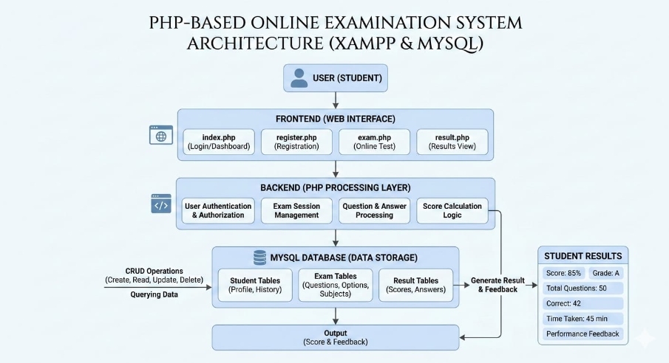
PROPOSED SYSTEM ARCHITECTURE
1
2
3
4
5
6
7
8
9

Slide 7
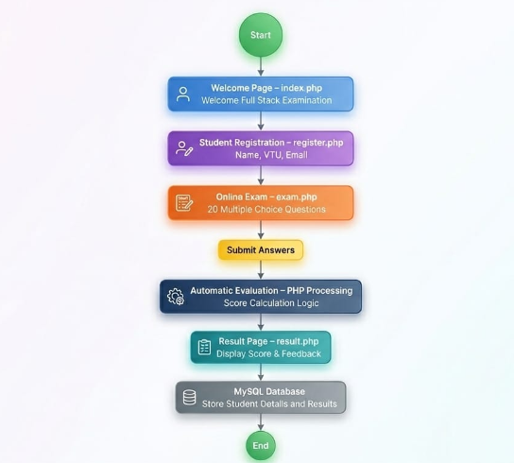
WORKFLOW
1
2
3
4
5
6
7
8
9

Slide 8
TECHNOLOGIES USED
1
HTML – Structure of web pages.
CSS – Styling and user interface design.
PHP – Server-side scripting for backend processing.
Apache Server (XAMPP) – Local server environment to host the application.
MySQL – Relational database for storing student and exam data.
phpMyAdmin – Database management tool for handling tables and queries.
Visual Studio Code – Code editor for development.
JavaScript (Optional Validation) – Client-side form validation and interactivity.
Web Browser (Chrome/Edge) – Used for testing and executing the application.
2
3
4
5
6
7
8
9

Slide 9
MODULE DESCRIPTION
Module 1: User Management
Handles student registration, login authentication, and session management.
Ensures secure access to the examination system.
Module 2: Examination Management
Manages question display, exam session handling, and answer submission for 20 multiple-choice questions.
Module 3: Evaluation & Result Processing
Automatically evaluates submitted answers, calculates scores, and generates performance feedback. Module 4: Database Management
Stores student details, exam questions, responses, and results securely using MySQL.
Ensures data integrity and retrieval.
1
2
3
4
5
6
7
8
9

Slide 10

IMPLEMENTATION SCREENSHOTS
1
Home Page (index.php)
Displays the welcome message and provides navigation to the registration page.
2
3
4
5
6
7
8
9

Slide 11
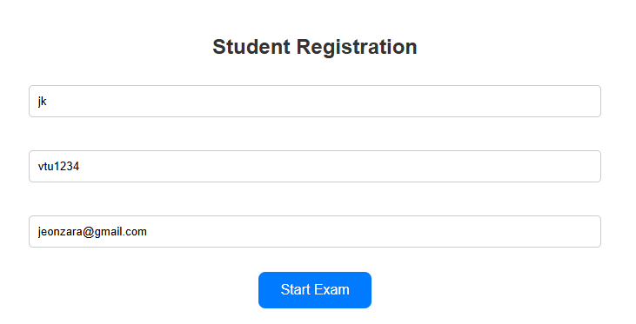
IMPLEMENTATION SCREENSHOTS
1
Login / Registration Page (register.php)
Allows students to enter Name, VTU, and Email to access the examination system.
2
3
4
5
6
7
8(A)
9

Slide 12
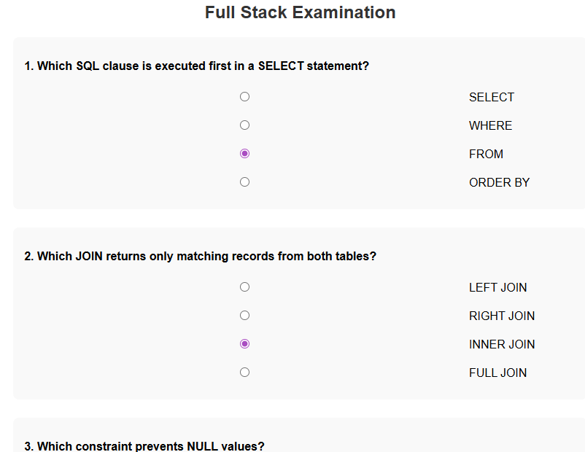
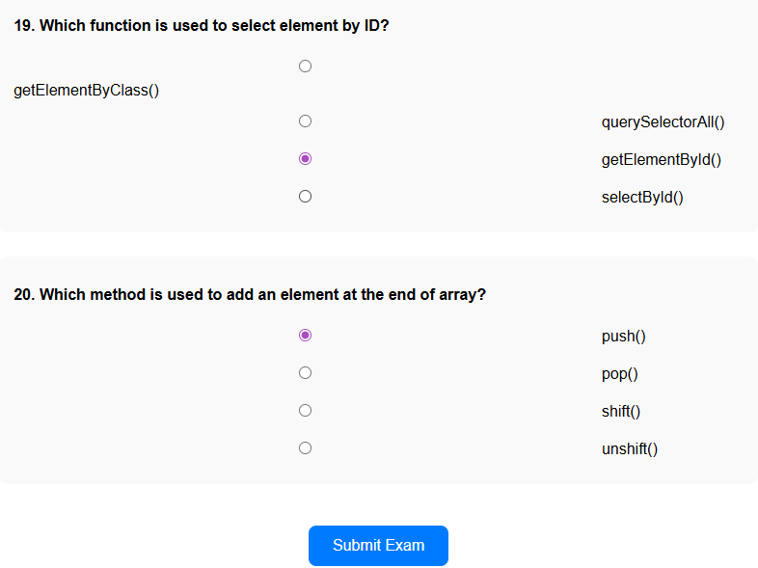
IMPLEMENTATION SCREENSHOTS
1
Main Module – Exam Page (exam.php)
Displays 20 multiple-choice questions and allows students to submit their answers.
2
3
4
5
6
7
8(B)
9

Slide 13

IMPLEMENTATION SCREENSHOTS
1
Output Page – Result (result.php)
Shows the calculated score and performance feedback after automatic evaluation.
2
3
4
5
6
7
8(C)
9

Slide 14
ADVANTAGES & LIMITATIONS
1
ADVANTAGES | LIMITATIONS
Provides instant result generation | Requires stable internet connection
Reduces manual paperwork | Depends on server performance
Minimizes human calculation errors | Limited to objective-type evaluation
Secure data storage in MySQL | Risk of technical issues during exam
2
3
4
5
6
7
8
9

Slide 15
Thank you

